Slide 1
A HYBRID ENSEMBLE ANTI-NOISE QUANTUM SUPPORT VECTOR MACHINE(QSVM) FOR ROBUST CLASSIFICATION
(Batch No. CBIT/IT/2025-26/IT2/201)
Under the Guidance of:
Dr. T. Satyanarayana Murty
Associate Professor, IT, CBIT
Presented by :
A. Nithisha - 160122737071
K. Varshitha - 160122737078
K.Prathyush - 160121737124

Slide 2
AGENDA
Problem Statement & introduction to Project.
Major Modules .
Project Requisites.
System Design
Implementation .
Results & Analysis
Summary
Future Scope
References

Slide 3
Problem Statement
Project Objectives & Plan:
Developing a hybrid quantum-classical model integrating neural networks, Anti-Noise QSVM, and ensemble learning for robust classification under noise.
Designing a noise-resilient framework capable of handling multiple noise types (label, feature, quantum hardware noise) for stable and accurate decisions.
Evaluating the model on benchmarks and comparing to classical and other QSVMs for scalability and robustness.
Quantum Support Vector Machines (QSVMs) are highly sensitive to noisy training data, which undermines their classification accuracy and stability. There is a critical need for a robust QSVM framework that integrates noise-resilient objective functions and sample-weighting strategies to enhance performanc in noisy environments without compromising quantum advantages.

Slide 4
Project Part-1: Publication Status
A Hybrid Ensemble Ati-Noise Quantum Support Vector Machine(QSVM) for Robust Classification
Authors: Satyanaraya Murthy,Varshitha Korepu,Allepu Nithisha,Prathyush
PAPER ID: VIEW26_RC_065
Accepted for presentation at Research Conclave 2026,organized by vignan’s Institute of Engineering for Women,Visakhapatnam, India on 26-February-2026. The work focuses on a hybrid ensemble model combining CNN and QSVM for robus classification under noisy conditions

Slide 5
Major Modules
Data Preprocessing Module Cleans and prepares noisy datasets using normalization, feature scaling, and noise injection techniques.
Feature Extraction Module Uses Neural Networks (TensorFlow/PyTorch) to extract meaningful and noise-resilient features.
Anti-Noise QSVM Module Implements Quantum Support Vector Machine with weighted hinge loss to handle noisy data.
Ensemble Learning Module Combines QSVM outputs with classical classifiers (SVM, Random Forest, etc.) for better accuracy.
Evaluation Module Compares performance using accuracy, precision, recall, and robustness under different noise types.

Slide 6
Project Requisites:
Technology Stack
1. Quantum Computing Tools:
Qiskit (IBM Quantum) for quantum circuit design, simulation, and noise modeling
2. Classical Machine Learning Frameworks:
Python libraries: scikit-learn (for SVM, ensemble classifiers)
TensorFlow or PyTorch (for neural network feature extraction)
3. Data Processing:
NumPy, Pandas, SciPy for numerical data manipulation and preprocessing
Datasets
Public benchmark datasets with suitable noisy data:
Handwritten digit recognition datasets (e.g., MNIST with noise augmentation)

Slide 7
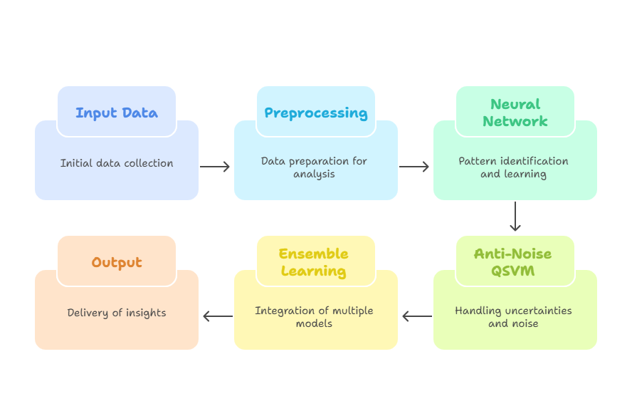
System Design:

Slide 8
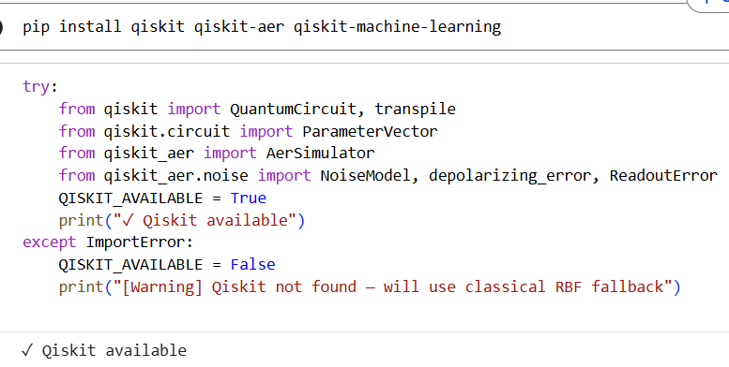
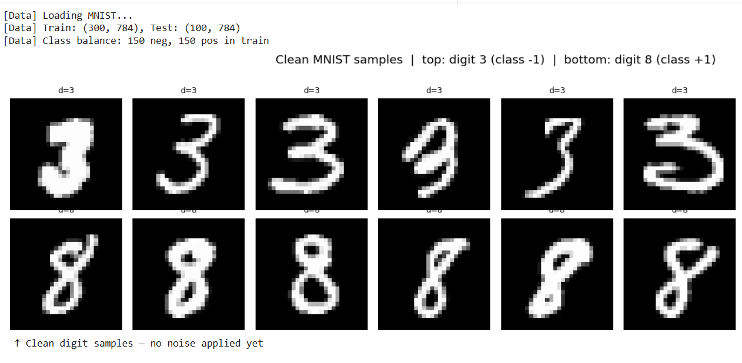
Implementation
Qiskit Installation

Slide 9
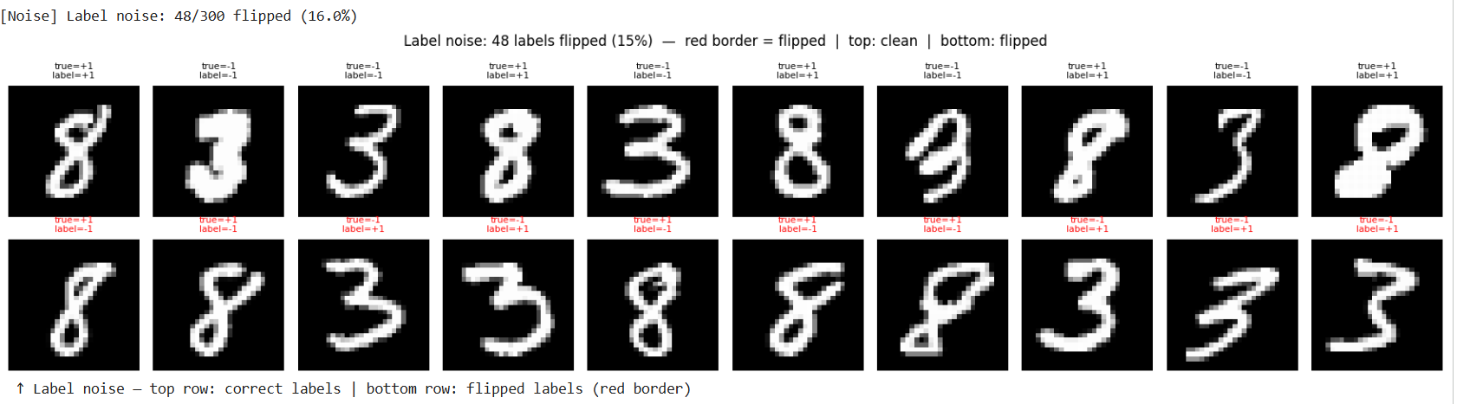
Implementation
.
Label Noise injected

Slide 10
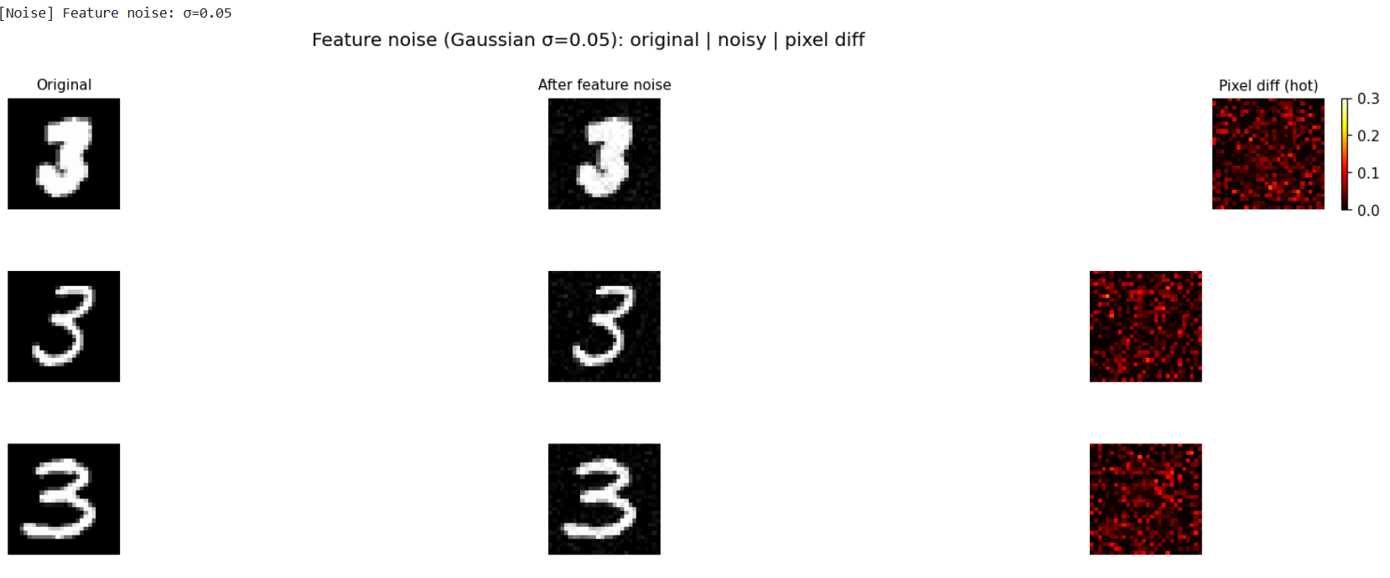
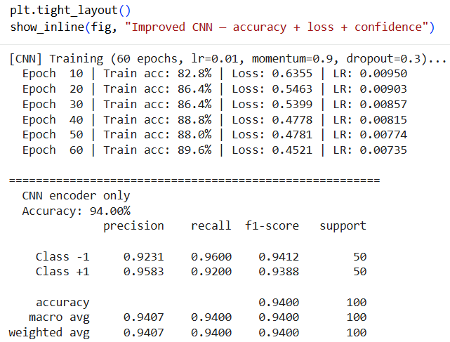
Implementation
.
CNN Model
Feature Noise injected

Slide 11
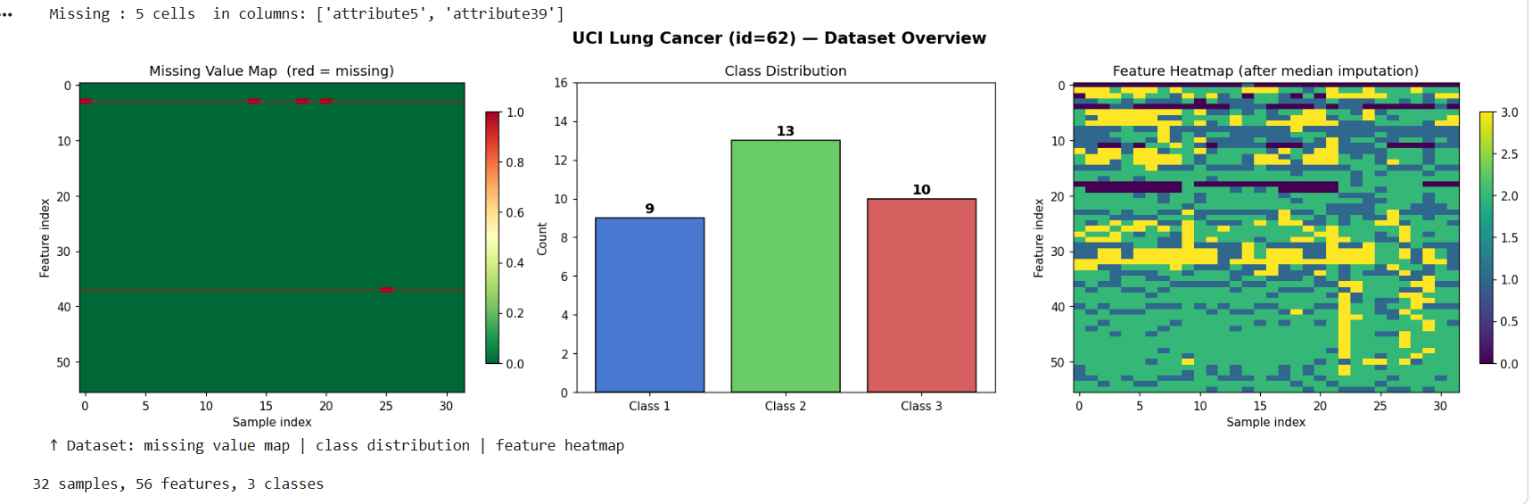
Implementation
.
Lung Cancer Dataset

Slide 12
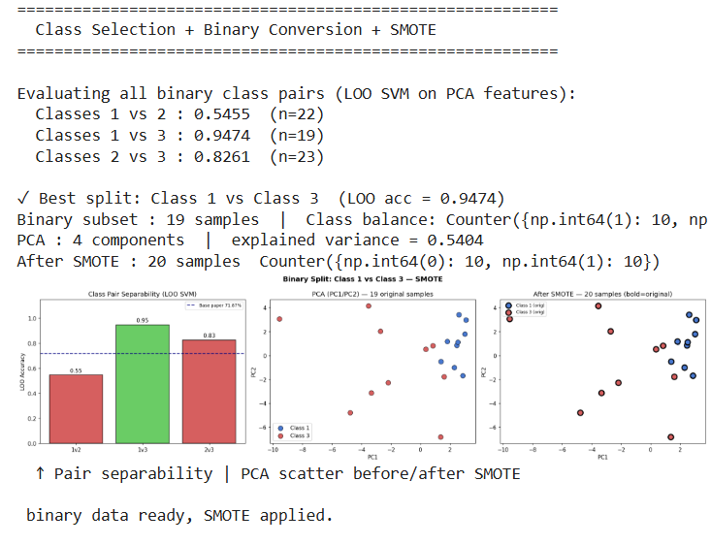
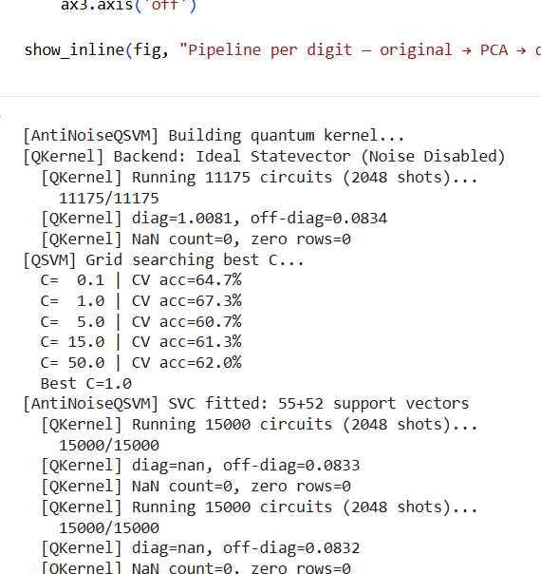
Implementation
.
Anti-Noise QSVM running
Binary Conversion

Slide 13
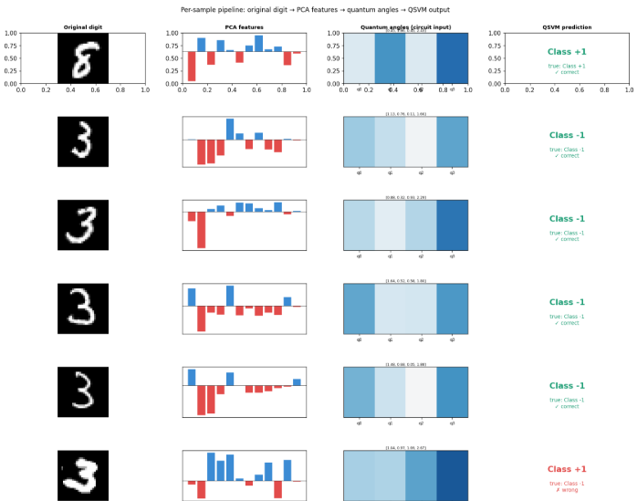
Results & Analysis

Slide 14
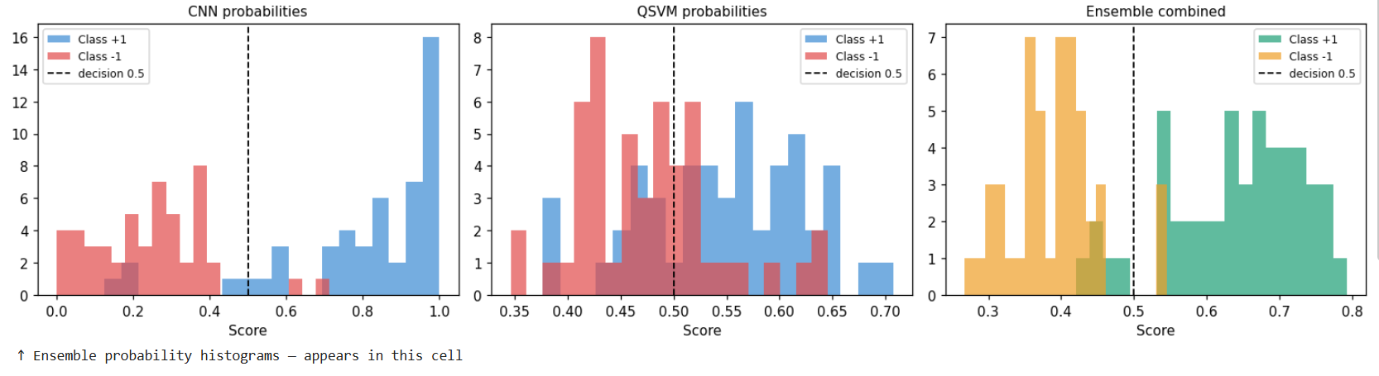
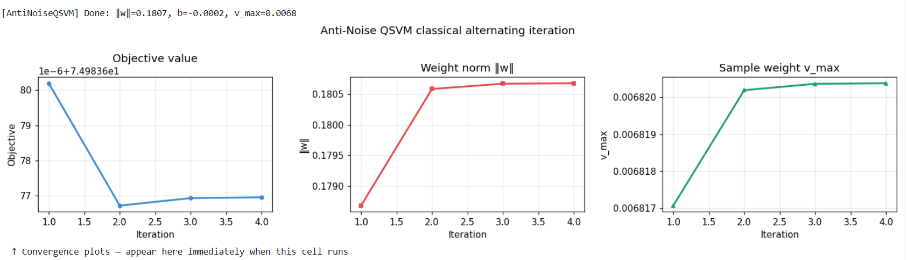
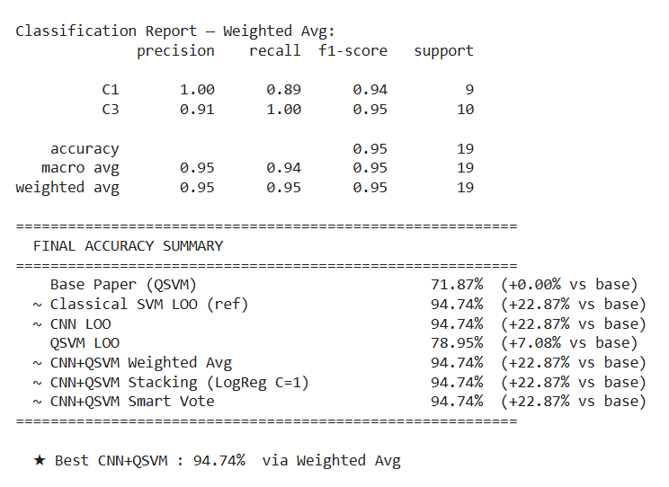
Results & Analysis

Slide 15
Summary
Proposes a hybrid quantum-classical model for classification
Combines Neural Networks, Anti-Noise QSVM, and Ensemble Learning
Neural network extracts noise-resilient features from data
Anti-Noise QSVM uses weighted hinge loss to reduce noise impact
Ensemble learning improves overall prediction performance
Achieves higher accuracy and stability
Provides better robustness against noisy data
Suitable for real-world applications with noisy datasets

Slide 16
Future scope
The future scope of this project includes implementing the proposed model on real quantum hardware such as IBM Quantum devices to evaluate its practical feasibility. Further optimization of quantum circuits can be carried out to improve execution speed and efficiency. The model can also be extended to handle large-scale datasets for broader applicability. In addition, this approach has strong potential for real-world applications in areas such as healthcare diagnosis, cybersecurity threat detection, and image processing. Integrating the system with advanced deep learning models could further enhance its performance and open new avenues in quantum machine learning research.

Slide 17
References
[1] G. Gentinetta, A. Thomsen, D. Sutter, and S. Woerner, “The complexity of quantum support vector machines,” Quantum, 2024. https://arxiv.org/pdf/2203.00031.pdf
[2] Anonymous, “Noise-robust optimization of quantum machine learning models,” IEEE Transactions, 2022. https://www.nature.com/articles/s41598-022-22940-4
[3] M. Akrom et al., “Entanglement detection with quantum support vector machines,” Nature Scientific Reports, 2025. https://www.nature.com/articles/s41598-025-95897-9
[4] J. Berberich et al., “Training robust and generalizable quantum models,” Phys. Rev. Research, 2024. https://journals.aps.org/prresearch/pdf/10.1103/PhysRevResearch.6.043326
[5] J. Wang et al., “Noisy HQNNs: A Comprehensive Analysis of Noise Robustness in Hybrid Quantum Neural Networks,” IEEE, 2021. https://arxiv.org/pdf/2505.03378.pdf
[6] J. Li et al., “Quantum Support Vector Machine for Classifying Noisy Data,” IEEE Transactions on Computers, 2024. https://ieeexplore.ieee.org/document/10564586
[7] M. Mafu and M. Senekane, “Design and Implementation of Efficient Quantum Support Vector Machine,” ICECET, 2021. https://ieeexplore.ieee.org/document/9385589
[8] S. Ahmed, “Pattern Recognition with Quantum Support Vector Machine on Near Term Quantum Processors,” PhD Dissertation, 2019. https://repository.bracu.ac.bd/xmlui/handle/123456789/1209
[9] H. Li et al., “Quantum Support Vector Machine Based on Gradient Descent,” Int. J. Theor. Phys., 2022. https://link.springer.com/article/10.1007/s10773-022-05100-0
[10] M. Senekane et al., “Prediction of Solar Irradiation Using Quantum Support Vector Machine Learning,” Smart Grid Renewable Energy, 2016. https://www.scirp.org/journal/paperinformation.aspx?paperid=68467

Slide 18
THANK YOU
QUERIES?
Batch No: 201
A. Nithisha - 160122737071
K. Varshitha - 160122737078
K.Prathyush - 160121737124

